Slide 1
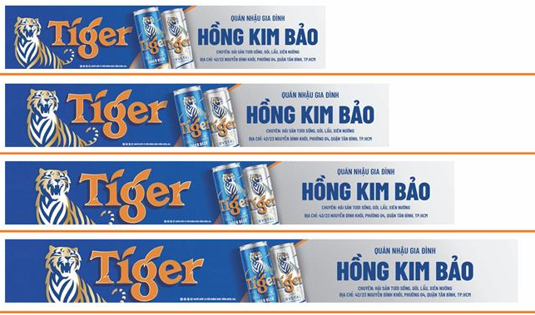
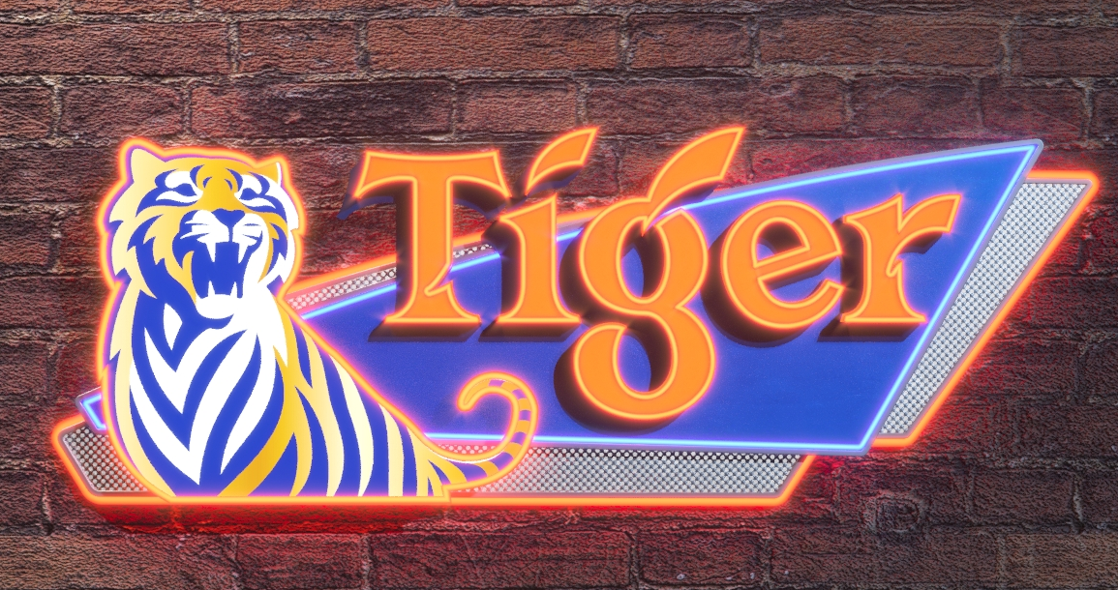
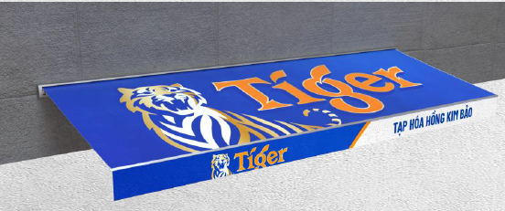
TIGER SIGNAGE DESIGN
LED SIGNAGE
(no change)
HIFLEX 4.0 (current design)

